Slide 1

CHOP R 101: Intro to R for Clinical Data
Transform
Notes:
Welcome back. This session is about Transforming, or Wrangling data.

Slide 2
a grammar for transforming data frames
Notes:
In this session I’ll introduce a set of functions from the dplyr package, which is part of the tidyverse. Dplyr is a grammar for transforming data frames. The image here is that it’ll give you a set of pliers with which you can bend the data to your will.
The idea behind dplyr is that any data analytic task can be broken down into a small number of basic or atomic tasks, and there should be a consistent way to specify each atomic task - a grammar.
As we will see in the next 30 minutes or so, each dplyr function takes a data frame, does something with it, and then returns a modified data frame as its output. Dplyr functions can be stringed together to create powerful data analysis pipelines in just a few lines of code.

Slide 3
Subsetting data
Notes:
Often times you have a large data frame but only want to create a graph from only a small part of it. Dplyr works great for this purpose.
Let’s look at how you can whittle down a data frame with dplyr.

Slide 4
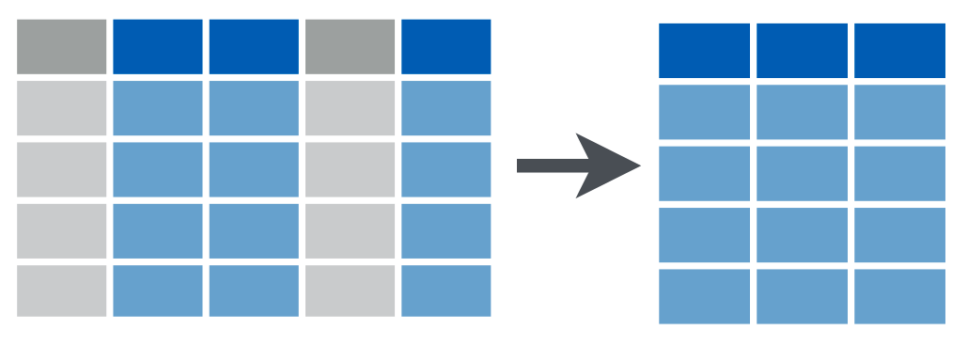

Subsetting columns vs rows
select()
filter()
Notes:
Dplyr provides two functions for subsetting data frames: select() for subsetting columns, and filter() for subsetting rows.

Slide 5
select()
Extract columns by name.
select(data_frame, ...)
names of columns to extract
Notes:
Let’s look at select() first. Select extracts columns from a data frame, by name.
Select takes a data frame as its first argument. After that it takes any number of additional arguments that specify the names of the columns that you want to pick.

Slide 6

select()
Extract columns by name.
select(covid_testing, mrn, last_name)
covid_testing
mrn | first_name | last_name | gender
5000876 | sarella | stark | female
5006017 | alester | stark | male
5001412 | jhezane | westerling | female
5000533 | penny | targaryen | female
mrn | last_name
5000876 | stark
5006017 | stark
5001412 | westerling
5000533 | targaryen
Notes:
For example, take the following code: “select of covid_testing, mrn, last_name”.
This select statement will take the data frame covid_testing, and return a new data frame that only has the columns mrn and last_name, highlighted in blue.
An important point to note here is that select will not modify the original data frame.
If you write the select statement like this it will simply print out the result in the console or in your R Markdown document. If you want to *capture* the modified data frame you need to assign it to a named object.
Q for class: do you remember how to capture data in a named object? Write the answer in the chat!

Slide 7
Your Turn #1
Which of the following will select the first_name column from the covid_testing data frame and capture the result in a data frame named newdata?
A) newdata = select(first_name, covid_testing)
B) newdata <- select(covid_testing, first_name)
C) select(newdata, covid_testing, first_name)
D) newdata <- select(covid_testing, First_Name)
E) Both B and D
Type your response in the chat!
Notes:
Points to make:
Use assignment operator to capture object
Select args: data frame, then columns
Case matters! First_name != first_name

Slide 8
filter()
Extract rows that meet logical criteria.
filter(data_frame, condition)
logical test (return each row for which the test is TRUE)
Notes:
One of the most important dplyr functions to know about is filter(). Filter extracts rows, and it does that based on logical criteria, or a condition.
Like select, filter takes a data frame as its first argument. The second argument is a condition or logical test. R then performs that logical test on each row of the dataset and returns all rows in which the logical test was true.

Slide 9
filter()
= sets
== compares
Extract rows that meet logical criteria.
filter(covid_testing, mrn == 5000083)
covid_testing
mrn | first_name | last_name
5000876 | sarella | stark
5006017 | alester | stark
5001412 | jhezane | westerling
5000083 | lollys | clegane
mrn | first_name | last_name
5000083 | lollys | clegane
FALSE
FALSE
FALSE
TRUE
Notes:
To give you an example: the logical test here is whether or not the mrn is equal to the 5000083. This is ** ** ** false for the first 3 rows in which the mrn is something else, but it’s ** true for the 4th row.
So this filter statement will ** return a data frame that only contains the 4th row, in which the logical condition is true, and that’s shown here on the right.
** One common issue I want to point out here is the difference between the single equals and the double equals operators.
You saw a single equals operator in the context of the aes() function where we set the x axis to a specific column name.
Here you see the double equals sign in the context of a logical test that compares the left hand side, e.g. mrn, with the right hand side, e.g. 5000083 to check whether or not they are the same.
If you use the wrong one you’ll get an error, and it’s a very common error and I want you guys to be aware of it.

Slide 10
Logical Operators
x < y | less than
x > y | greater than
x == y | equal to
x <= y | less than or equal to
x >= y | greater than or equal to
x != y | not equal to
is.na(x) | a missing value
Notes:
Here are some important logical operators to know about. They will all come in handy when you’re filtering rows of a data frame. x and y each represent expressions, which could be column names or constant values or a combination thereof.
We’ve already seen the double equals. Note the less than or and greater than operators. These operators also come as “or equal to” versions.
Use != if you want to select rows in which a value is not equal to another vale.
is.na is how you can test for missing values. This comes in handy when you want to remove missing values from your data, which we’ll see later.

Slide 11
Your Turn #2
Write a filter() statement that returns a data frame containing only the rows from covid_testing in which the last_name column is NOT equal to "stark".
(You don’t have to capture the returned data frame)
Type your response in the chat!
Notes:
filter(covid_testing != “stark”)

Slide 12
Values coded as character strings must be surrounded by quotes
filter(covid_testing, last_name != "stark")
covid_testing
mrn | first_name | last_name
5000876 | sarella | stark
5006017 | alester | stark
5001412 | jhezane | westerling
5000083 | lollys | clegane
mrn | first_name | last_name
5001412 | jhezane | westerling
5000083 | lollys | clegane
FALSE
FALSE
TRUE
TRUE
Notes:
** Delete from deck **
So this was a little bit tricky. The correct answer is filter of covid_testing, last_name != “stark”, and “stark” needs to be in quotes.
A few points to make here:
The logical operator for NOT equals is exclamation point equals. When we go through the covid_testing data frame row by row, we see this expression will be false for the first two rows where the last_name is “stark” and true for the last two rows where the last_name isn’t “stark”.
The second point is that when you’re doing a comparison with a literal character string, such as “stark”, that needs to go into quotes. A character string is anything that’s not a number or a logical value such as TRUE and FALSE.

Slide 13
Your Turn #3
Which of these would successfully filter the covid_testing data frame to only tests with positive results?
A) filter(covid_testing, result == positive)
B) filter(covid_testing, result = "positive")
C) filter(covid_testing, result == "positive")
D) filter(covid_testing, positive == "result")
Notes:
A is wrong because “positive” is a character string (it’s not a number or a logical value such as TRUE/FALSE).
B is wrong because you’re trying to do a comparison with a single equals.
C is correct D is wrong because it flips the positions of the comparison; the column name goes to the left and the comparator on the right.

Slide 14
The pipe operator %>%
Notes:
I’ll now introduce one of the most powerful concepts in the tidyverse – the pipe operator, which is written as percent-greater than-percent.
I’ll first show you exactly what it does, and then why it’s so useful.

Slide 15
The Pipe Operator %>%
covid_testing %>% filter( , pan_day <= 10)
Passes the object on the left as first argument to the function on the right.
filter(covid_testing, pan_day <= 10) covid_testing %>% filter(pan_day <= 10)
Notes:
The pipe operator takes the object on its left - here the covid_testing data frame - and ** plugs it as the first argument of the function on its right - here as the first argument to the filter function.
** So if you look at the first line of code here – a filter function where the first argument is the covid_testing data frame that we’re passing in – we can re-write this as covid_testing pipe filter(pan_day <= 10)
Those two lines of code are equivalent. In both cases we’re covid_testing gets passed as the first argument to the filter() function.

Slide 16
”then”
covid_testing %>%
select(last_name, result) %>%
filter(result == "positive")
Notes:
So here’s why this is so useful.
Tidy functions (such select, filter, and others we’ll see later) always have as first argument a data frame, and they always return a data frame.
This makes it possible to create a pipeline in which a data frame object is handed from one dplyr function to the next.
** The pipe operator is usually pronounced “then”.
For example, here we start with covid_testing, then select the last_name and result columns, then filter for results equal to “positive”.
You’ll get a pipeline of data analysis steps which are concise and also fairly human readable. This is powerful because it makes is way easier to explain to someone who doesn’t know R what you did.

Slide 17
Your Turn #4
Rewrite the following statement with a pipe:
select(mydata, first_name, last_name)
Type the answer in the chat!
Notes:
mydata %>% select(first_name, last_name)

Slide 18
Create new columns

Slide 19
mutate()
Create new calculated columns.
mutate(data_frame, name = value)
new column name
calculation (can include data from other columns)
single =
Notes:
Mutate is an extremely useful dplyr function, and you can use it to make new variables or columns.
Like all dplyr functions, mutate() takes a data frame as its first argument. After that, you tell it what to name the new column and what should be in it. This is done using name-value expressions.
In name-value expression, you have a name, a equals sign, and a value. The name is the ** name of the new column that you’d like to create. Then you have a ** single equals sign - because you’re setting something to something else, you’re not testing whether two things are the same. Then you have the ** value. This can be a constant, e.g. “100”, or a calculation that involves data from other columns.

Slide 20
mutate()
Create new calculated columns.
mutate(covid_testing,
col_rec_tat_mins = col_rec_tat * 60)
mrn | col_rec_tat
5000876 | 29.5
5006017 | 3.6
5001412 | 1.4
5000533 | 2.3
mrn | col_rec_tat | col_rec_tat_mins
5000876 | 29.5 | 1770
5006017 | 3.6 | 216
5001412 | 1.4 | 84
5000533 | 2.3 | 138
Notes:
For example, let’s take a look at one of the columns of covid_testing, col_rec_tat.
This column contains the specimen collection to received-in-lab turn around time, in hours. Let’s create a new column, that contains the same data, but in minutes.
To do so, you write mutate(covid_testing) followed by a name value expression. The left part is the new column name, col_rec_tat_mins. Then we have a single equals sign. Then the calculation, which is col_rec_tat times 60. You can see that mutate creates the new column and fills each row with the result of the calculation.

Slide 21
Your Turn #5
Open 03 – Transform.Rmd and work through the exercises.
Click “yes” when you are finished.

Slide 22
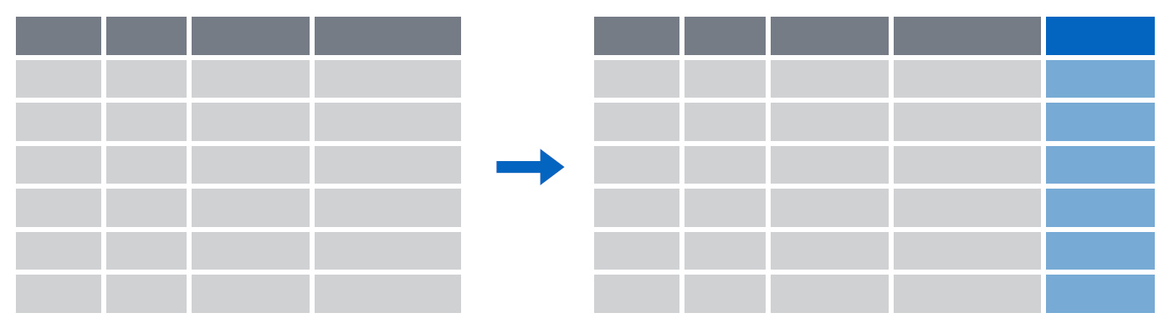
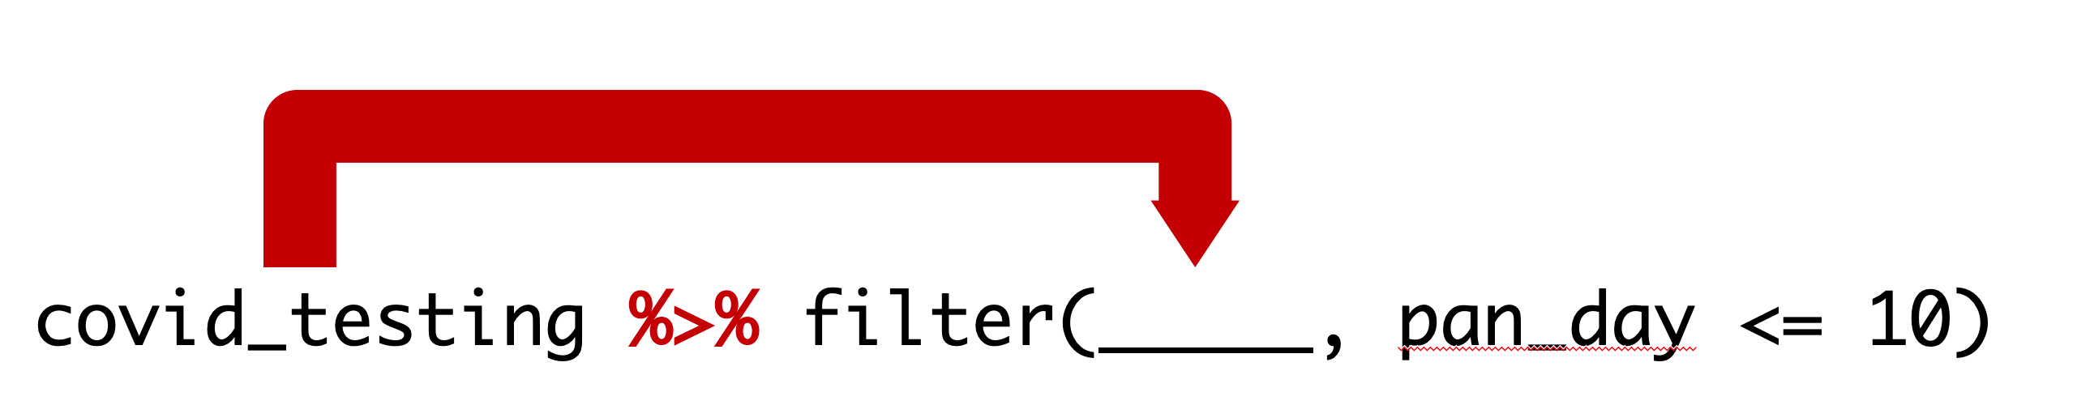
Recap
select() subsets columns by name
filter() subsets rows by a logical condition
mutate() creates new calculated columns
Use the pipe operator %>% to combine dplyr functions into a pipeline
Notes:
To recap, dplyr provides a grammar for transforming data frames. Some of the key dplyr functions are:
** select(), which subsets columns by name;
** filter(), which subsets rows by a logical condition; and
** mutate(), which creates new calculated columns.
** The pipe operator, written %>%, can be used to string together dplyr functions into a pipeline.

Slide 23
What else?

Slide 24
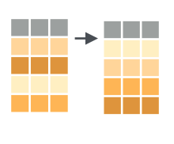
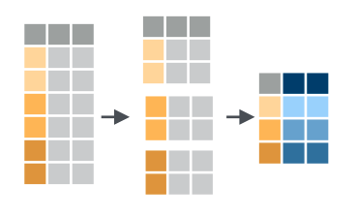
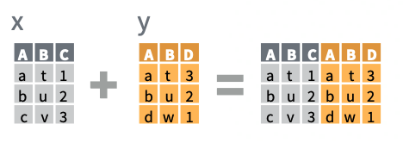
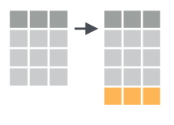
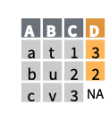
More dplyr functions
arrange(data, ...)
data %>%
group_by(...) %>%
summarize(...)
x %>%
bind_cols(y)
add_row(data, ...)
x %>%
left_join(y)
Notes:
We’ve only scratched the surface of data transformation functions in dplyr. Other important ones include:
** arrange(), which sorts a data frame
** add_row(), which adds rows to a data frame
** group_by and summarize, which allow you to create data summaries such as means, medians, sums, etc.
** bind_cols and bind_rows, which allows you to combine data frames by row or column; and
** _join functions including left_join() that combine data frames by looking up matching values from one table in another.

Slide 25
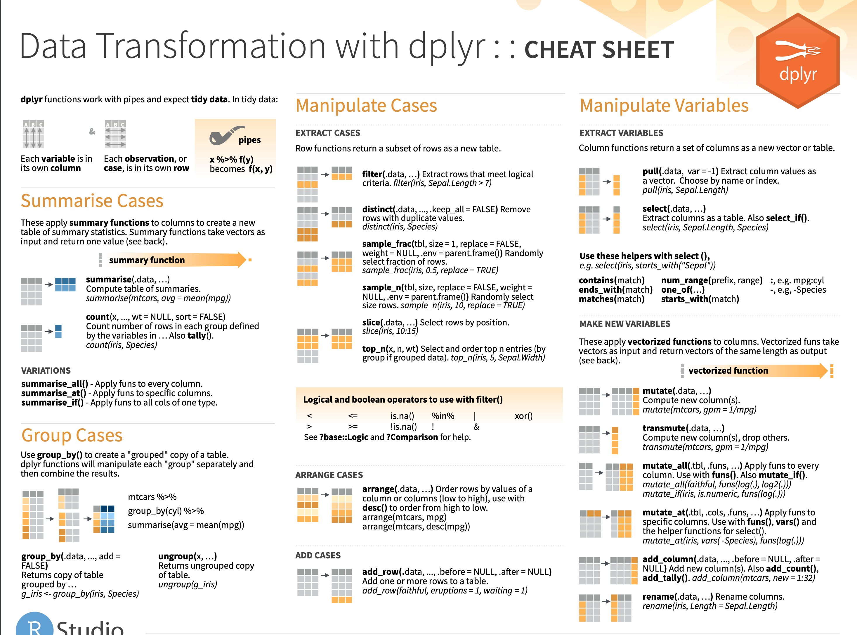
Notes:
There is a dplyr cheat sheet which gives a great overview of those functions. I’ve linked it on the course website.

Slide 26
Notes:
Beyond dplyr, there are a number of other packages that provide powerful tools for data transformation
Tidyr provides a lot more functions like dplyr that allow you to convert messy data frames into tidy ones
Lubridate provides functions to manipulate times and dates
Stringr provides tools for manipulating pieces of text
Purrr offers advanced functionality to automate complex data transformations
And Dbplyr allows you to interact with a table inside a database as if it were a data frame.

Slide 27
What next?
Notes:
So this brings us to the end of the workshop! One of the most frequent questions we get is what can I do to keep learning R after the workshop. We have a few suggestions for that.

Slide 28
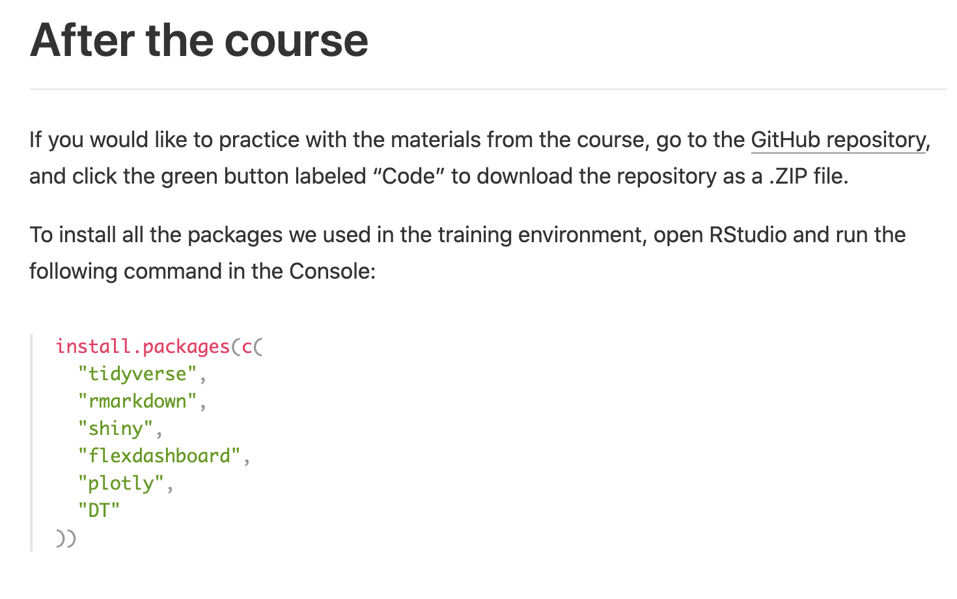

Install R and RStudio on your computer!
https://skadauke.github.io/intro-to-r-for-clinicians-chop/
Notes:
The first thing EVERYBODY should do is to install R and Rstudio on your own computer. ** Check out the video walkthroughs on the course website for help with this.
** Also, if you’d like to practice with the materials of the course on your own computer, the course website has instructions on how you can download them. We will also post a recording of this session on the website within the next 48 (Joy?) hours, so you will always be able to watch it for a refresher.

Slide 29

Get involved with the CHOPR User Group
bit.ly/chopRusers
Notes:
The next thing that we recommend is to become part of a community of practice. The best way to do that is to join the CHOP R User group (which is also open to Penn folks). I can’t overstate the importance of having a place to go to ask for help when you start coding. The CHOP R User group has more than 350 members from all departments. This is great place to network with other R users, get help with coding problems, and learn about new packages, webinars, and conferences. We also have semi-regular meetings, and are always looking for new people to present short “lightning talks” about something they’ve been working on, a cool new package they’ve discovered, or really anything related to their experience with R. We welcome talks from a variety of experience levels, so as you continue to get your feet wet with R, consider whether there’s something you’d be open to presenting about! Either way, we hope you join us for our next meeting, which will be shared via the CHOPR email distribution list as well as in our Slack.
We’ve also just launched two new Slack channels: #memes for sharing lighthearted humor about R, statistics, data science, and more, and #wins – a place to celebrate all your successes, big and small. Learning to code can be a frustrating process at times – in the next few weeks, keep an eye out for those “heck yes!” moments when something finally clicks into place, and consider sharing it with the community so we can celebrate everyone’s progress together.

Slide 30

https://r4ds.had.co.nz
https://jrnold.github.io/r4ds-exercise-solutions/
https://rfordatasci.org
Notes:
Finally, I wanted to point out that “R For Data Science” by Garrett Grolemund and Hadley Wickham is the de-facto standard introduction to data science with R.
This course is designed so that you can pick up this book and keep learning - we use the same packages and conventions as in that book. The entire text is available for free at this address. Each chapter has a lot of exercises,
** and there’s a solutions manual for the exercises online, which makes this great for self-paced learning.
** there’s also an amazing online community that was borne out of the book that has evolved into an incredibly vibrant and active slack community filled to the brim with resources and cheerful folks in all stages of their data science journey.

Slide 31

Participate in #TidyTuesday
Notes:
The aforementioned R4DS community has an initiative known as “Tidy Tuesday” – each week a new dataset is released, with a goal of allowing you to practice your data transformation and visualization skills. Lots of people who participate share their code and visualizations widely and openly, so you can get a great sense for what is possible in R just by browsing the hashtag on twitter.
If you do end up participating, we’d love to hear about it in the CHOPR slack!

Slide 32

Help us update our slides
Email franzenr@chop.edu if you’re game to help or want to learn more.
Notes:
Finally, one of the best ways to protect against that infamous “forgetting curve” is to review the material again after a little while.
We just so happen to need some help with a task that will allow you to do that, give back to the CHOP R community, AND expose yourself to some of the really cool possibilities with R Markdown files all at the same time.
As of right now, our slides for this workshop content are produced in PowerPoint, which has a few downsides, like not allowing us to easily keep track of changes made to our content across time as we adapt based on learner feedback.
Additionally, PowerPoint slides aren’t particularly accessible to folks who use screen readers, which obviously isn’t good, as it’s important to us to allow as many learners as possible to benefit from our materials.
We mentioned earlier in the day that there’s lots of cool things you can do with R Markdown and one of those things is generate slide decks! This has lots of benefits, like being able to always have the latest version of your data and figures in your slides with just a click of a button.
Additionally, since markdown code is entirely text based, it’s much more accessible to screen readers (provided you remember to insert “alt text” or alternative text for any visual elements).
We’ve been hoping to transfer our slides from powerpoint to R Markdown, and we realized this could be a great mini project for someone (or several someones)!
You’d be given the content, a clear template for the markdown, and any additional instruction needed. Since there are so many slides to transfer, it would be great to have multiple different people who are willing to tackle different chunks, and there’s no expectation of how many slides you’ll contribute – we’re happy to have any help, and want this to be as low pressure as possible!
If you’re interested in helping out, send an email to me franzenr@chop.edu, and sometime next week I’ll reach out to begin to coordinate.

Slide 33

Thank You!!
Atu Agawu
Sara Mchugh-grant
Kelli Cooper
Rachel Brown
Rich Hanna
Rose Hartman
Joy Payton
Notes:
At this point, I would like to thank all the helpers--
** So to give them a round of virtual applause please click the “yes” button one last time!

